Slide 1
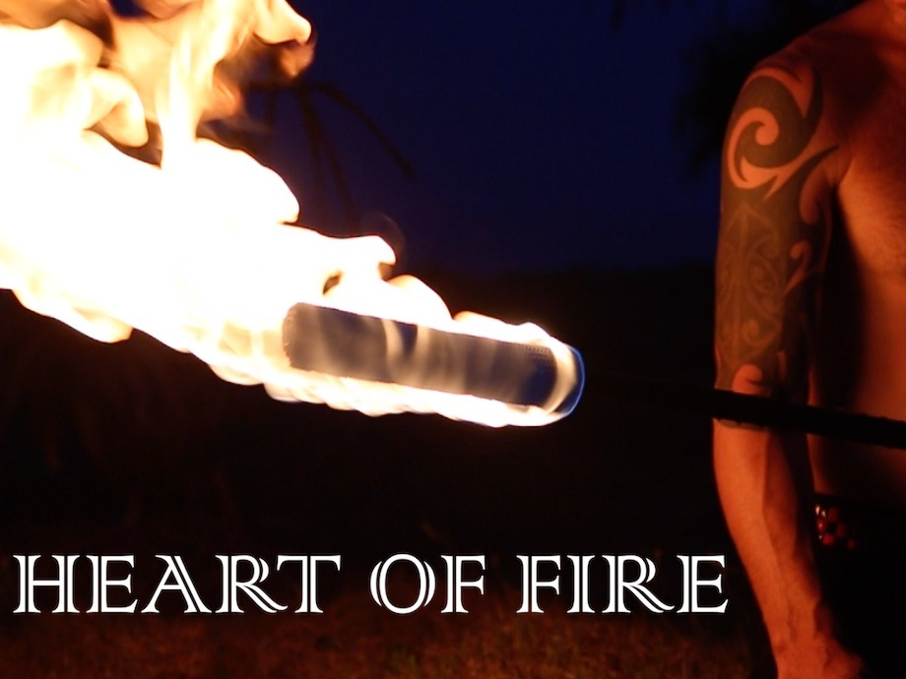
DUST TEMPLE
54 Currumbin Creek Road
Thursday 5th March 6pm - 11pm
Live music from
Juzzie Smith
Matthew Armitage
Mitch King
$25
each
Fire shows ~ ‘La Fuente Fire’ & ‘Fire Beats’
Energy Entertainments proudly presents
CROWDFUNDING EVENT
For tickets & more information visit EnergyEntertainments.com.au or call Neal ~ 0423 364 207

